Slide 1
CS F415: Data Mining
Yashvardhan Sharma

Slide 2
Today’s Outline
Introduction
Motivation
What is Data Mining
Origins of Data Mining

Slide 3

Motivation: Commercial Viewpoint
Lots of data is being collected and warehoused
Web data, e-commerce
purchases at department/ grocery stores
Bank/Credit Card transactions
Computers have become cheaper and more powerful
Competitive Pressure is Strong
Provide better, customized services for an edge (e.g. in Customer Relationship Management)

Slide 4
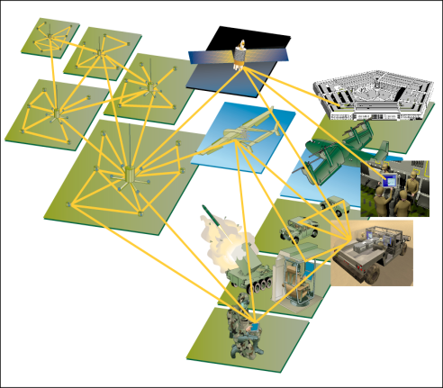
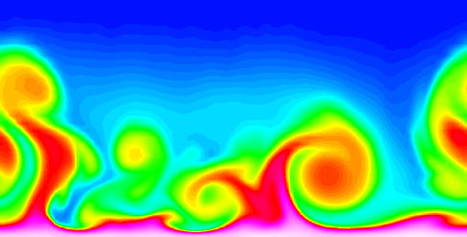
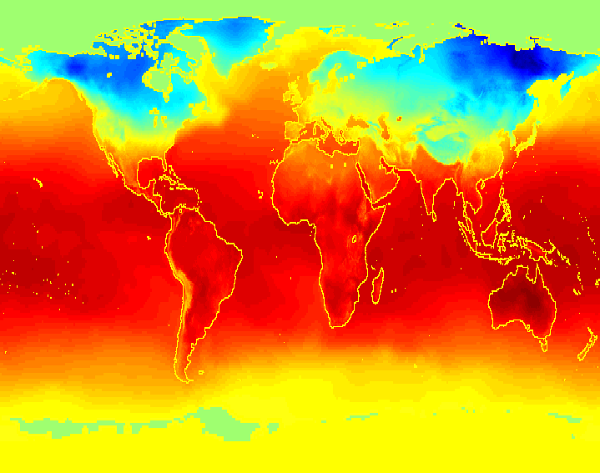
Motivation: Scientific Viewpoint
Data collected and stored at enormous speeds (GB/hour)
remote sensors on a satellite
telescopes scanning the skies
microarrays generating gene expression data
scientific simulations generating terabytes of data
Traditional techniques infeasible for raw data
Data mining may help scientists
in classifying and segmenting data
in Hypothesis Formation

Slide 5
Motivation
A (simplistic) view of Data Mining:
Models are the “product” of data mining
--Strategic decisions are supported on the inferred models
Data Mining
Data
(Information)
Models
(Knowledge)

Slide 6
Motivation
Problem
IS’s and DB’s make it possible to convert data into information, but make it difficult to convert information into knowledge.
This cannot be done manually any more.

Slide 7
Motivation
Old tools:
Data Source:
Transactional Database:
Relational or Object-Relational Data Organisation
Information Delivery (Exploitation) Tools:
Batch Reporting Tools
EIS (Executive Information Systems)
Traditional DSS (Decision Support Systems)
Desktop Reporting Tools (Spreadsheet Add-ins,…)

Slide 8
Motivation
New tools:
Data Source:
Data warehouses or operational data stores.
Other models: multidimensional
Other organisations: datamarts
Exploitation tools:
OLAP (On-Line Analytical Processing) Tools.
Data Mining
Simulation

Slide 9
Motivation
Needs and Tools:
Operational decisions → operational queries:
Requirement Examples:
“Are there available seats for flight IB-2323?”.
» TOOL: SQL.
“List the products which currently have a special offer”.
» TOOL: SQL/Reporting tools.

Slide 10
Motivation
Needs and Tools:
Tactical decisions → aggregated queries:
Requirement Example:
“Top ten sellers in the sales department during the last year”.
» TOOL: SQL, OLAP tools, data warehouses
“Total sales of seaside supermarkets in the second quarter of 2005 vs. total sales of interior supermarkets”.
» TOOL: DSS, OLAP tools, data warehouses

Slide 11
Motivation
Needs and Tools:
Planning → descriptive or predictive models:
Requirement Examples:
“Products which are sold together frequently in seaside supermarkets”.
» TOOL: Descriptive Data Mining
“Sales expected for next quarter for all products in category “multimedia”.
» TOOL: Predictive Data Mining
“Expected penetration rates of offer 1 after offer 2 in interior supermarkets”.
» TOOL: Predictive Data Mining + Simulation

Slide 12
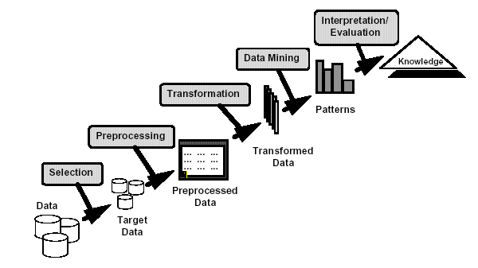
What is Data Mining?
Many Definitions
Non-trivial extraction of implicit, previously unknown and potentially useful information from data
Exploration & analysis, by automatic or semi-automatic means, of large quantities of data in order to discover meaningful patterns

Slide 13
What is NOT Data Mining?
Originally a “statistician” term
Overusing of data to draw invalid inferences
Bonferroni's theorem warns us that if there are too many possible conclusions to draw, some will be true for purely statistical reasons, with no physical validity.
Famous example: David Rhine, a “parapsychologist" at Duke in the 1950's tested students for Extra Sensory Perception(ESP) by asking them to guess 10 cards - red or black. He found about 1/1000 of them guessed all 10, and instead of realizing that is what you'd expect from random guessing, declared them to have ESP. When he retested them, he found they did no better than average.
His conclusion: telling people they have ESP causes them to lose it!

Slide 14
What is (not) Data Mining?
What is not Data Mining?
Look up phone number in phone directory
Query a Web search engine for information about “Amazon”
What is Data Mining?
Group together similar documents returned by search engine according to their context (e.g. Amazon rainforest, Amazon.com,)
customers who buy diapers are more likely to buy beer

Slide 15
Origins of Data Mining
Draws ideas from machine learning/AI, pattern recognition, statistics, and database systems, parallel computing and Distributed Computing
Traditional Techniques may be unsuitable due to
Enormity of data
High dimensionality of data
Heterogeneous, distributed nature of data
Statistics/ AI
Machine Learning/
Pattern Recognition
Data Mining
Database systems

Slide 16
Challenges of Data Mining
Scalability
Dimensionality
Complex and Heterogeneous Data
Data Quality
Data Ownership and Distribution
Privacy Preservation
Streaming Data

Slide 17
Data Mining
Learning
Predictive
Descriptive
Classification
Prediction
Summarization
Clustering
Time Series Analysis
Sequence Discovery
Regression
Association Rules

Slide 18
Data Mining Tasks
Prediction Methods
Use some variables to predict unknown or future values of other variables.
Description Methods
Find human-interpretable patterns that describe the data.

Slide 19
Classification: Definition
Given a collection of records (training set )
Each record contains a set of attributes, one of the attributes is the class.
Find a model for class attribute as a function of the values of other attributes.
Goal: previously unseen records should be assigned a class as accurately as possible.
A test set is used to determine the accuracy of the model. Usually, the given data set is divided into training and test sets, with training set used to build the model and test set used to validate it.

Slide 20
Classification Example
categorical
categorical
continuous
class
Test
Set
Learn
Classifier
Training
Set
Model

Slide 21
Classification: Application 1
Direct Marketing
Goal: Reduce cost of mailing by targeting a set of consumers likely to buy a new cell-phone product.
Approach:
Use the data for a similar product introduced before.
We know which customers decided to buy and which decided otherwise. This {buy, don’t buy} decision forms the class attribute.
Collect various demographic, lifestyle, and company-interaction related information about all such customers.
Type of business, where they stay, how much they earn, etc.
Use this information as input attributes to learn a classifier model.

Slide 22
Classification: Application 2
Fraud Detection
Goal: Predict fraudulent cases in credit card transactions.
Approach:
Use credit card transactions and the information on its account-holder as attributes.
When does a customer buy, what does he buy, how often he pays on time, etc.
Label past transactions as fraud or fair transactions. This forms the class attribute.
Learn a model for the class of the transactions.
Use this model to detect fraud by observing credit card transactions on an account.

Slide 23
Classification: Application 3
Customer Attrition/Churn:
Goal: To predict whether a customer is likely to be lost to a competitor.
Approach:
Use detailed record of transactions with each of the past and present customers, to find attributes.
How often the customer calls, where he calls, what time-of-the day he calls most, his financial status, marital status, etc.
Label the customers as loyal or disloyal.
Find a model for loyalty.

Slide 24
Classification: Application 4
Sky Survey Cataloging
Goal: To predict class (star or galaxy) of sky objects, especially visually faint ones, based on the telescopic survey images (from Palomar Observatory).
3000 images with 23,040 x 23,040 pixels per image.
Approach:
Segment the image.
Measure image attributes (features) - 40 of them per object.
Model the class based on these features.
Success Story: Could find 16 new high red-shift quasars, some of the farthest objects that are difficult to find!

Slide 25
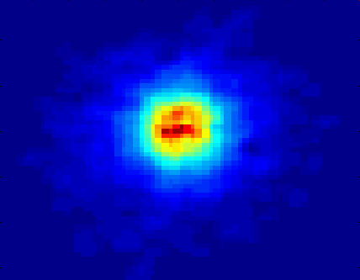
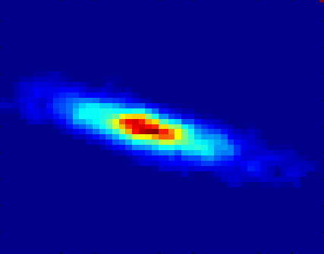
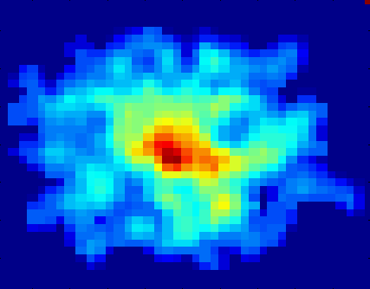
Classifying Galaxies
Early
Class:
Stages of Formation
Attributes:
Image features,
Characteristics of light waves received, etc.
Intermediate
Late
Data Size:
72 million stars, 20 million galaxies
Object Catalog: 9 GB
Image Database: 150 GB
Courtesy: http://aps.umn.edu

Slide 26
Clustering Definition
Given a set of data points, each having a set of attributes, and a similarity measure among them, find clusters such that
Data points in one cluster are more similar to one another.
Data points in separate clusters are less similar to one another.
Similarity Measures:
Euclidean Distance if attributes are continuous.
Other Problem-specific Measures.

Slide 27
Illustrating Clustering
Euclidean Distance Based Clustering in 3-D space.
Intracluster distances
are minimized
Intercluster distances
are maximized

Slide 28
Clustering: Application
Document Clustering:
Goal: To find groups of documents that are similar to each other based on the important terms appearing in them.
Approach: To identify frequently occurring terms in each document. Form a similarity measure based on the frequencies of different terms. Use it to cluster.
Gain: Information Retrieval can utilize the clusters to relate a new document or search term to clustered documents.

Slide 29
Illustrating Document Clustering
Clustering Points: 3204 Articles of Los Angeles Times.
Similarity Measure: How many words are common in these documents (after some word filtering).

Slide 30
Association Rule Discovery: Definition
Given a set of records each of which contain some number of items from a given collection;
Produce dependency rules which will predict occurrence of an item based on occurrences of other items.
Rules Discovered:
{Milk} --> {Coke}
{Diaper, Milk} --> {Beer}

Slide 31
Association Rule Discovery: Application 1
Marketing and Sales Promotion:
Let the rule discovered be
{Bagels, … } --> {Potato Chips}
Potato Chips as consequent => Can be used to determine what should be done to boost its sales.
Bagels in the antecedent => Can be used to see which products would be affected if the store discontinues selling bagels.
Bagels in antecedent and Potato chips in consequent => Can be used to see what products should be sold with Bagels to promote sale of Potato chips!

Slide 32
Association Rule Discovery: Application 2
Supermarket shelf management.
Goal: To identify items that are bought together by sufficiently many customers.
Approach: Process the point-of-sale data collected with barcode scanners to find dependencies among items.
A classic rule --
If a customer buys diaper and milk, then he is very likely to buy beer.
So, don’t be surprised if you find six-packs stacked next to diapers!

Slide 33
Association Rule Discovery: Application 3
Inventory Management:
Goal: A consumer appliance repair company wants to anticipate the nature of repairs on its consumer products and keep the service vehicles equipped with right parts to reduce on number of visits to consumer households.
Approach: Process the data on tools and parts required in previous repairs at different consumer locations and discover the co-occurrence patterns.

